Slide 1

实施生成树

Slide 2
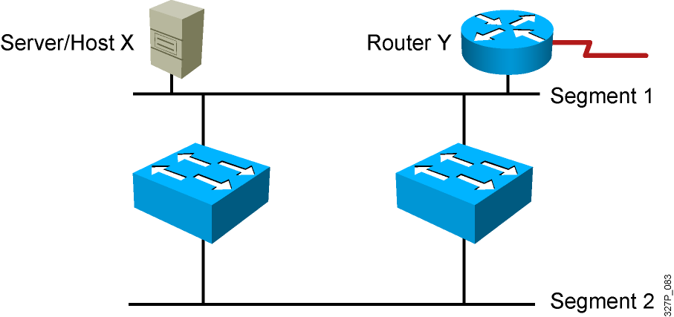
冗余拓扑的设计
- 冗余拓扑能够解决单点故障问题；
- 冗余拓扑造成 广播风暴, 多帧复用, MAC地址不稳定的问题；
Notes:
Emphasize: Layer 2 has no mechanism (like a TTL) to stop loops.

Slide 3
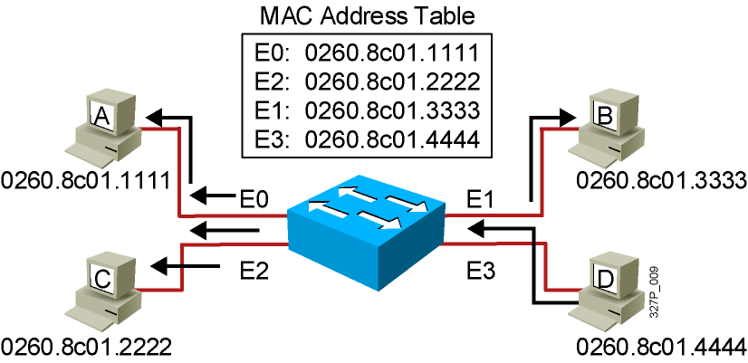
广播帧
- 站点D发送一个广播帧；
- 广播帧除源端口以外任意端口泛洪；

Slide 4
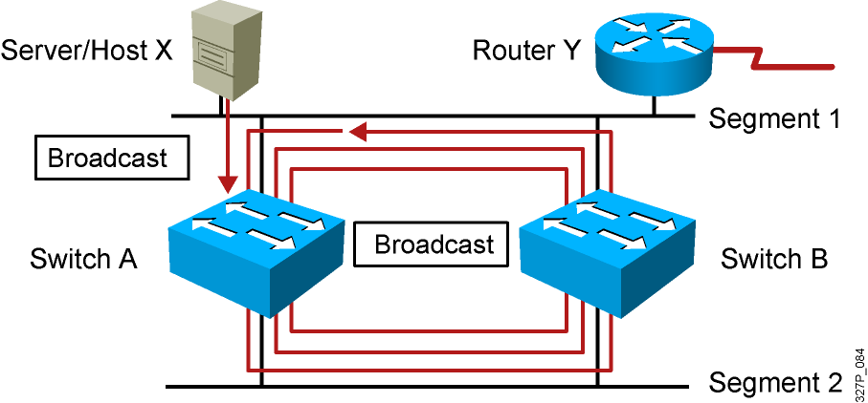
广播风暴
- Host X发送广播帧；
- 交换机继续没完没了的更新广播流量；
Notes:
Layer 3 of 3
Emphasize: Layer 2 has no TTL mechanism to stop looping frames.

Slide 5
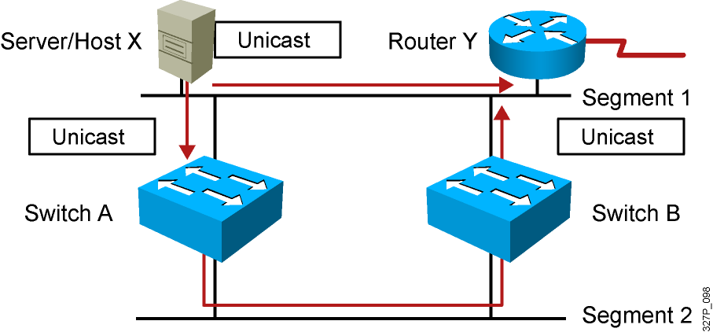
多帧复用
- Host X 发送一个单播数据帧给 Router Y；
- Router Y 的MAC地址还没有被每个交换机学习到；
- Router Y 接收2份相同的数据帧的拷贝；
Notes:
Layer 2 of 2

Slide 6
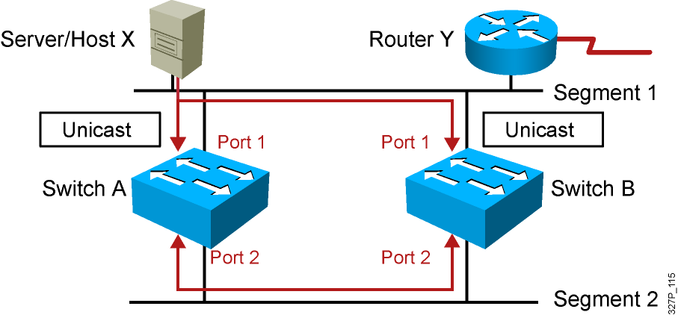
MAC地址表的不稳定
- Host X 发送一个单播数据帧给 Router Y；
Router Y 的MAC地址还没有被每个交换机学习到；
Switches A and B 在Port1上学习到Host X的MAC地址；
- 到达Router Y的数据帧被泛洪；
- Switches A and B 不正确的在Port2上学习到Host X的MAC地址；
Notes:
Layer 2 of 2

Slide 7
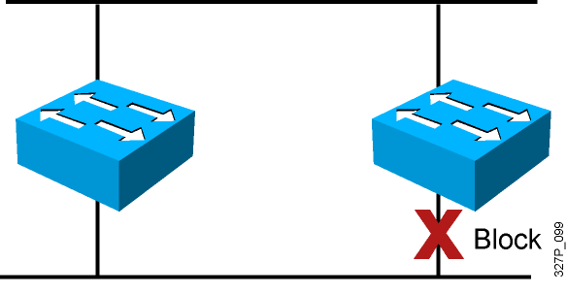
采用生成树STP解决环路
- 通过将特定的端口选为 Blocking state，来实现无环的拓扑；
- IEEE 802.1D 规定了这一行为；
- Cisco采用IEEE802.1D的增强的私有协议生成树PVST+;
Notes:
Emphasize: A looped topology is often desired to provide redundancy, but looped traffic is undesirable. The Spanning-Tree protocol was originally designed for bridges. Today, it is also applied to LAN switches and routers operating as a bridge. Spanning-Tree protocol ensures that all bridged segments are reachable but any points where loops occur will be blocked.

Slide 8
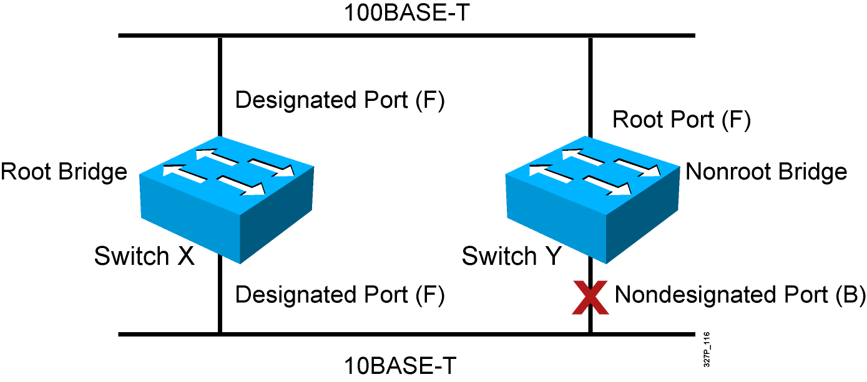
生成树STP的操作
- 每个广播域选择一个根桥；
- 每个非根桥上选择一个根端口；
- 每个段选择一个指定端口；
- 选择一个非指定端口；
Notes:
Emphasize: The three general rules when dealing with STP are as follows:
1. One root bridge per network. The root is the bridge with the lowest bridge ID. All the ports on the root bridge are designated ports (forwarding).
2. For every non-root bridge, there is a root port (forwarding). The root port is the port with the lowest accumulated path cost to the root bridge.
3. For every segment, there is only one designated port. The designated port forwards traffic for the segment. The designated port has the lowest accumulated path cost to the root bridge.

Slide 9
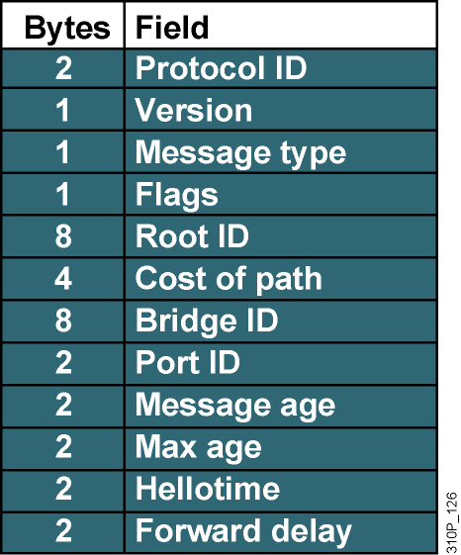
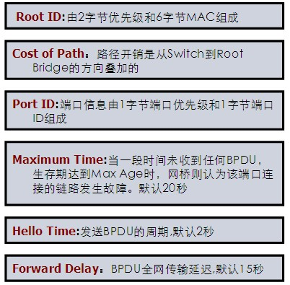
BPDU(Bridge Protocol Data Unit )
BPDUs 在交换机之间交换信息

Slide 10
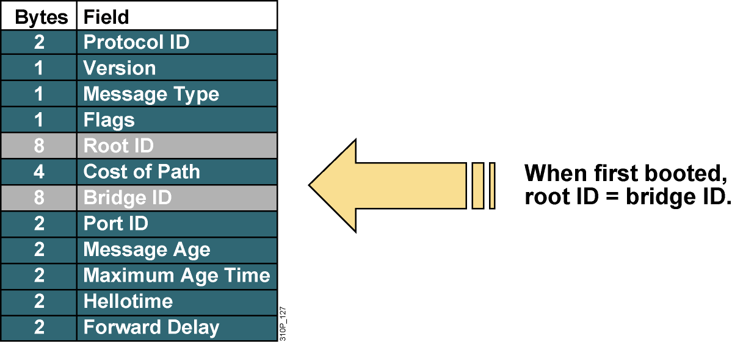
根桥的选举

Slide 11
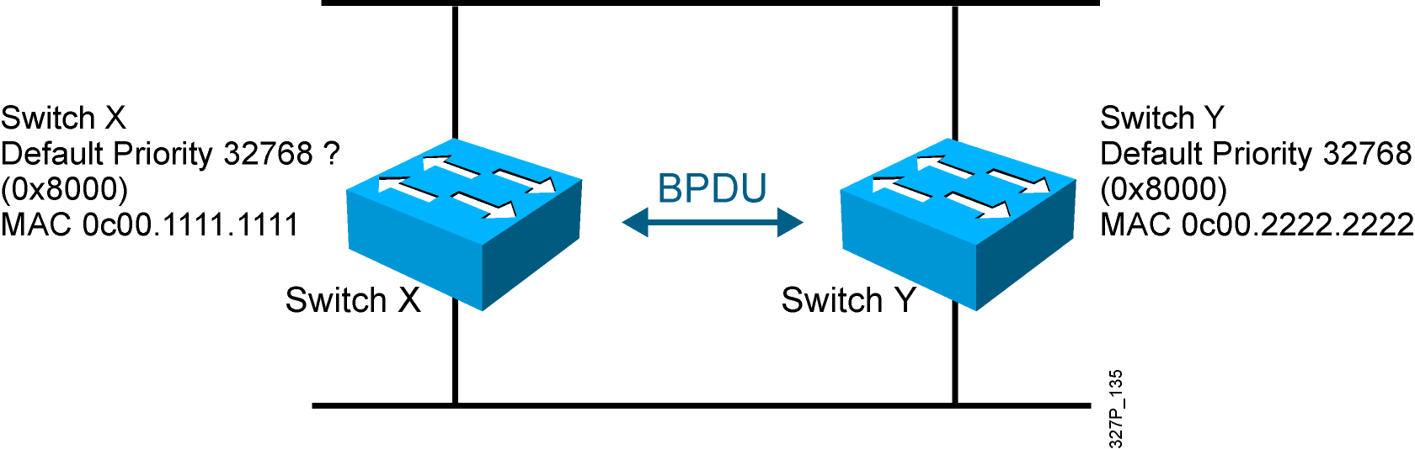
STP根桥的选举
- BPDU (default = sent every 2 seconds)
- Root bridge = bridge with the lowest bridge ID
- Bridge ID =
Bridge
Priority
MAC
Address
Notes:
Emphasize: By default, the switch with the lowest MAC address will be the root bridge.
Note: The Catalyst switches support an instance of spanning tree per VLAN. Each VLAN will use a unique MAC address for spanning tree purposes. On the Catalyst 1900, the address it uses for spanning tree is the MAC address on the various ports. VLAN is discussed in the next chapter.
The IEEE 802.1d specification specifies for a 16-bit priority field. The Catalyst 1900 switch only supports the 802.1d Spanning-Tree protocol. The default priority on the Catalyst 1900 is 32768 in decimal or 8000 in hex, the midrange value.
BPDU contain the following fields:
Protocol ID version
Message type
Flags
Root ID
Cost of path
Bridge ID
Port ID
Message age
Max age
Hello time
Forward delay

Slide 12
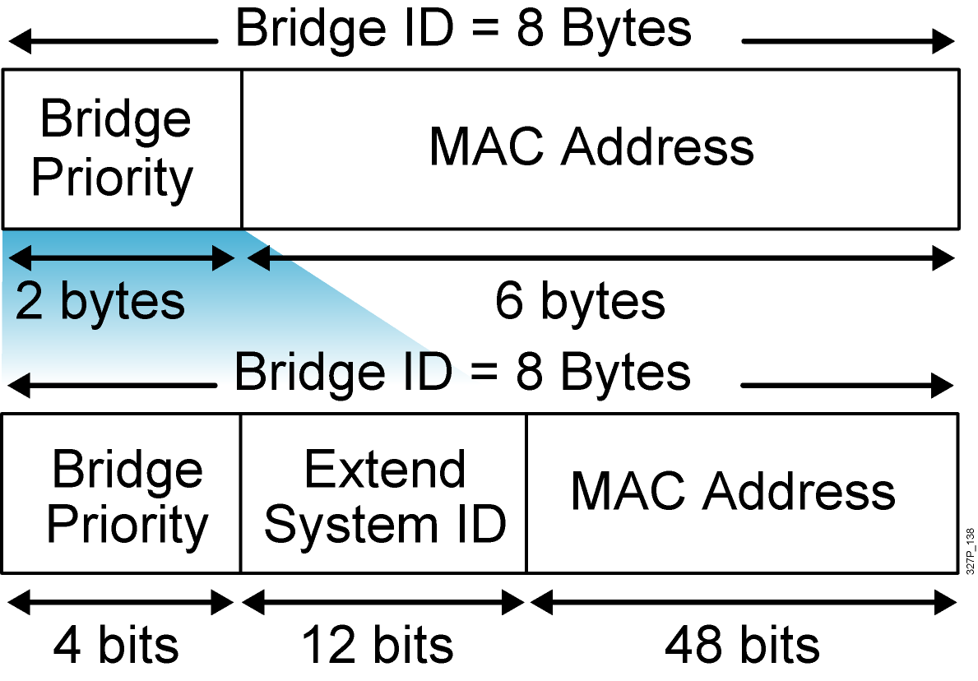
PVST+ Extended Bridge ID
Bridge ID without the
extended system ID
Extended bridge ID
with system ID
System ID = VLAN

Slide 13
手动配置根桥和备份根桥
Switch(config)#
spanning-tree vlan 1 root primary
强制VLAN 1为交换机的根桥；
Switch(config)#
spanning-tree vlan 2 root secondary
配置交换机为VLAN2的备份根桥；
或者
Switch(config)#
spanning-tree vlan # priority priority
修改交换机VLAN优先级 (优先级为4096的倍数).

Slide 14
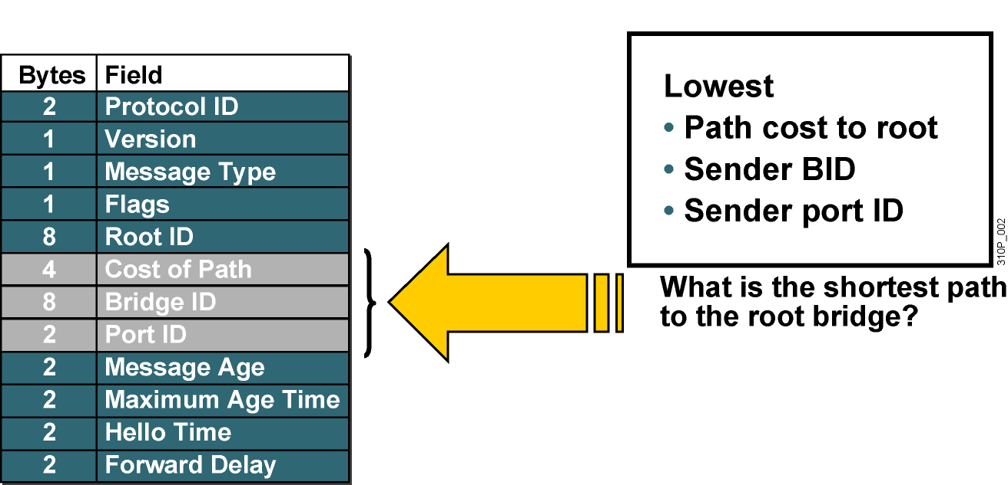
根端口的选举

Slide 15
STP路径开销
Link Speed | Cost (New IEEE Specification) | Cost (Old IEEE Specification)
10 Gb/s | 2 | 1
1 Gb/s | 4 | 1
100 Mb/s | 19 | 10
10 Mb/s | 100 | 100
Notes:
Emphasize: There are two cost calculation methods. The Catalyst 1900 uses the older method. The new method is designed to accommodate the higher gigabit Ethernet speed.
Note:
Port priority is used to determine which path has preference when path costs are equal (for example, when you have two parallel links connecting two switches together). The default port priority is 128.
The port aggregation protocol and EtherChannels® are not taught in this class.
Fast EtherChannel is supported by the Catalyst 1900 switch.

Slide 16
根端口的选举
Fast Ethernet
DP
RP
DP
Nondesignated Port
Ethernet
  Switch X 是根桥；
  Switch Y 需要选择一个根端口；
  Fast Ethernet total cost = 0 + 19.
  Ethernet total cost = 0 + 100.

Slide 17
指定端口的选举
Fast Ethernet
DP
RP
DP
Nondesignated Port
Ethernet
  Switch X是根桥；
  根桥上所有的端口都是指定端口，因为他们的路径开销为 0；
  因为 Ethernet链路的路径开销为100, switch Y 会阻塞这个端口；

Slide 18
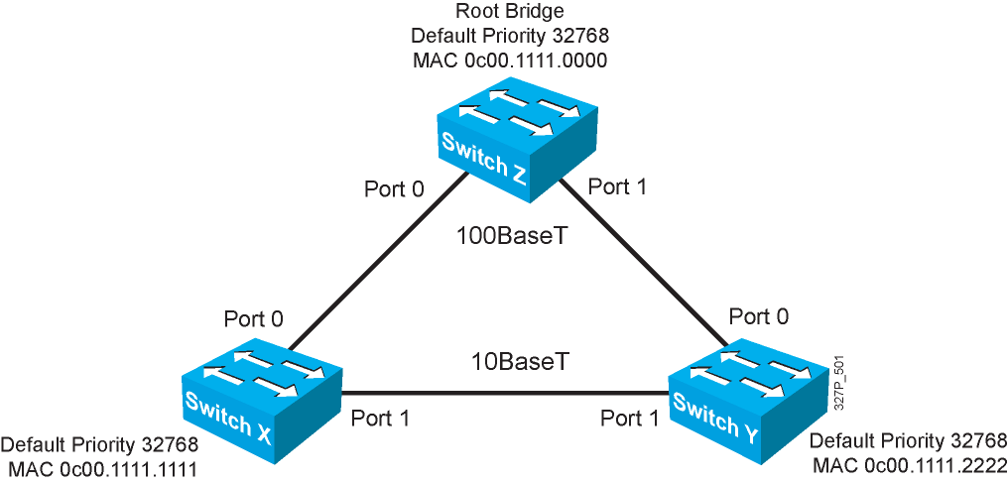
练习：STP操作示例
Notes:
Layer 2 of 2
Emphasize: Switch X and Y have the same path cost to the root bridge. The DP for the bottom segment is on switch X because switch X has a lower bridge ID than switch Y.

Slide 19
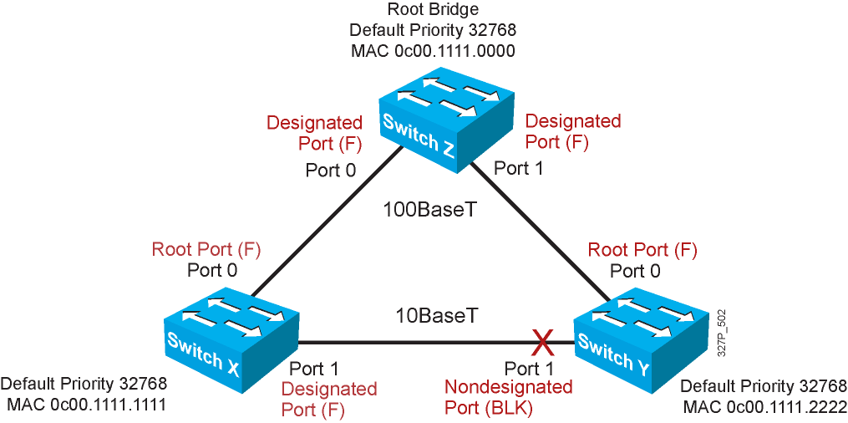
练习：STP操作示例
Notes:
Emphasize: RPs and DPs are normally in the forwarding state.
There is only one DP per segment.

Slide 20
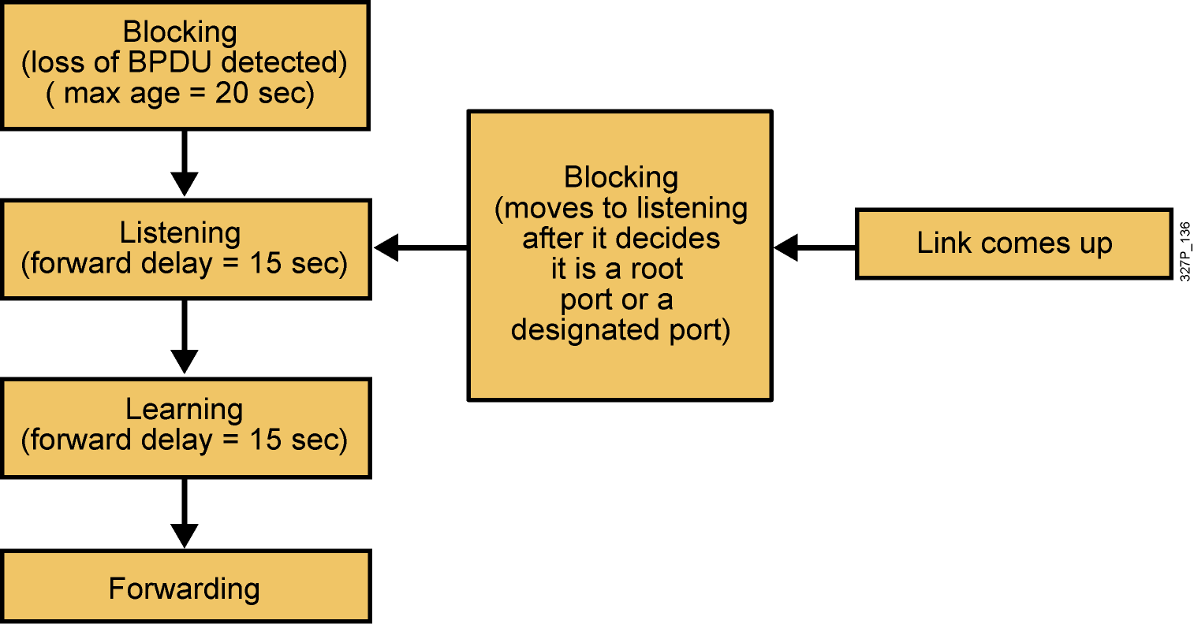
STP端口状态
每个端口的不同生成树状态：
Notes:
Emphasize: Using the default Spanning-Tree protocol timers setting, the times it takes to go from the blocking state to the forwarding state is 50 sec (20 + 15 + 15).

Slide 21
STP端口状态
In the blocking state, ports can only receive BPDUs. It may take up to 20 seconds to change from this state；
In listening state, switches determine if there are any other paths to the root bridge. the forward delay and lasts for 15 seconds. In the listening state, user data is not being forwarded and MAC addresses are not being learned；
In learning state user data is not forwarded, but MAC addresses are learned from any traffic that is seen. The learning state lasts for 15 seconds and is also called the forward delay；
In forwarding state user data is forwarded and MAC addresses continue to be learned. BPDUs are still processed；

Slide 22
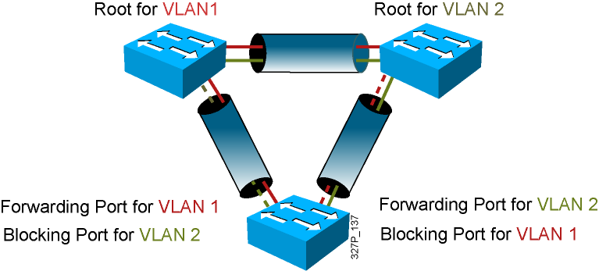
PVST+的负载均衡

Slide 23
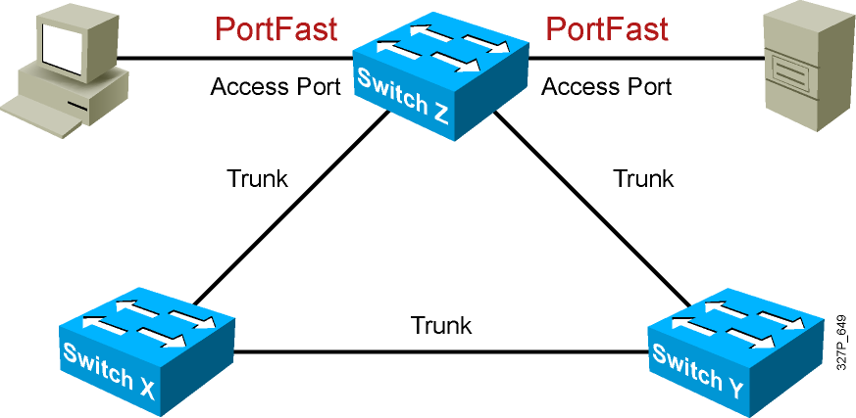
STP特性PortFast
PortFast 被配置在Access端口上, 而不是在 trunk端口上

Slide 24
配置STP特性PortFast
Switch(config-if)#
spanning-tree portfast
在接口上配置PortFast 属性
或者
Switch(config)#
spanning-tree portfast default
全局下对所有的 non-trunking 端口启用PortFast 属性
Switch#
show running-config interface interface
查看接口配置Portfast的情况

Slide 25
RSTP (802.1W)

Slide 26
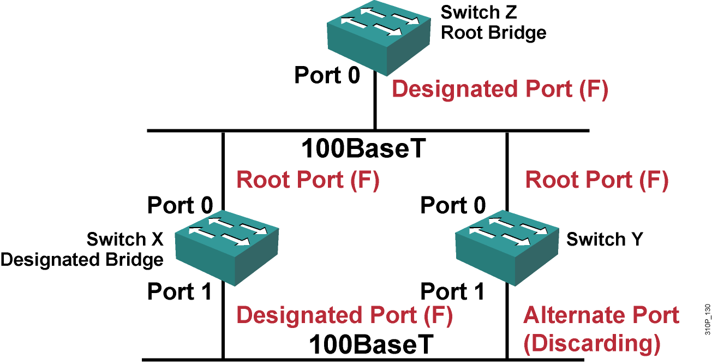
Rapid Spanning Tree Protocol(802.1w)
802.1W相对于先前的802.1D生成树来说,在网络拓扑发生变化的时候提供更快的收敛速度，RSTP中还集成了类似于uplink和backbonefast属性.
Notes:
仍然是单实例的STP协议，内存需求比802.1高，但是比RPVST+要小一些

Slide 27
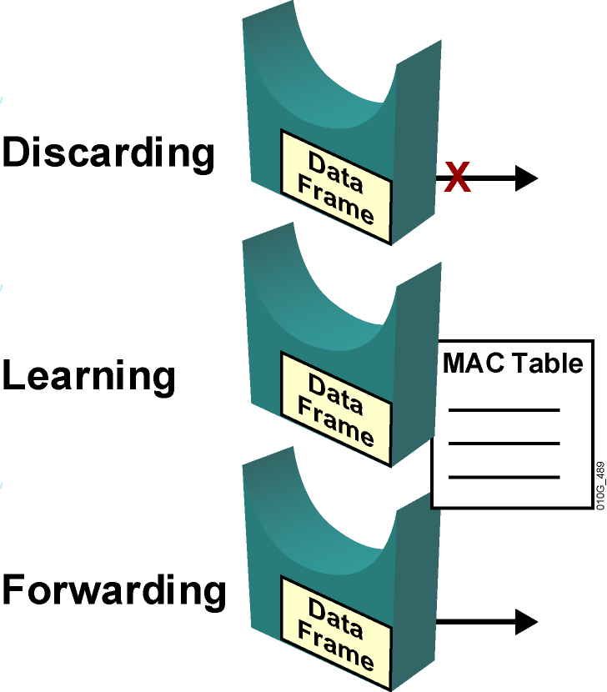
RSTP Port States

Slide 28
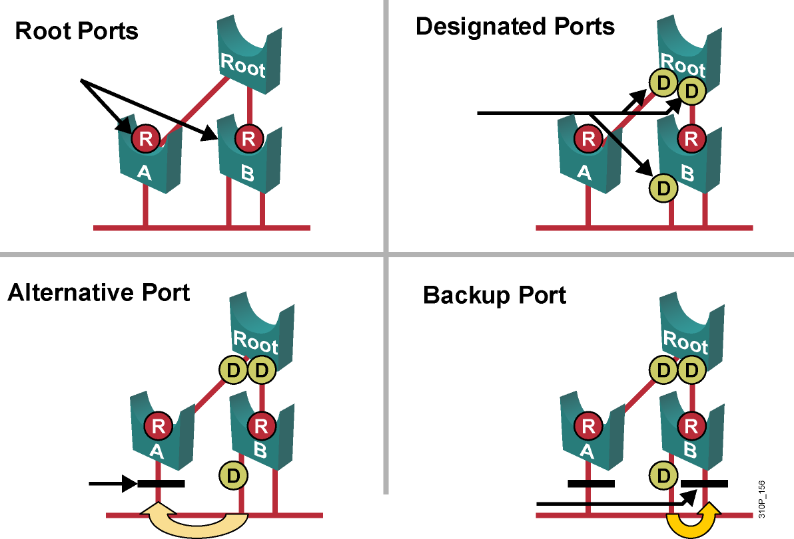
RSTP Port Roles

Slide 29
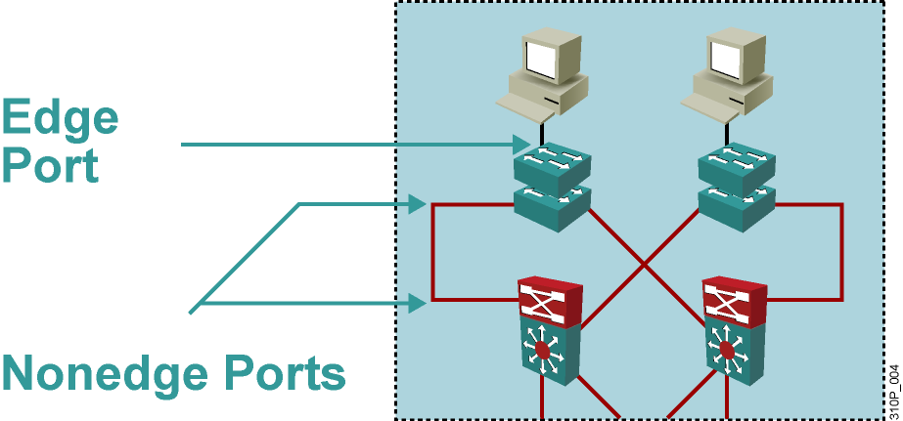
What Are Edge Ports?
  Will never have a switch connected to it.
  Immediately transitions to forwarding.
  Functions similarly to PortFast（思科）.
  Configured by issuing the spanning-tree portfast command（思科）.
  When a edge port receives a BPDU,it generates a TCN.

Slide 30
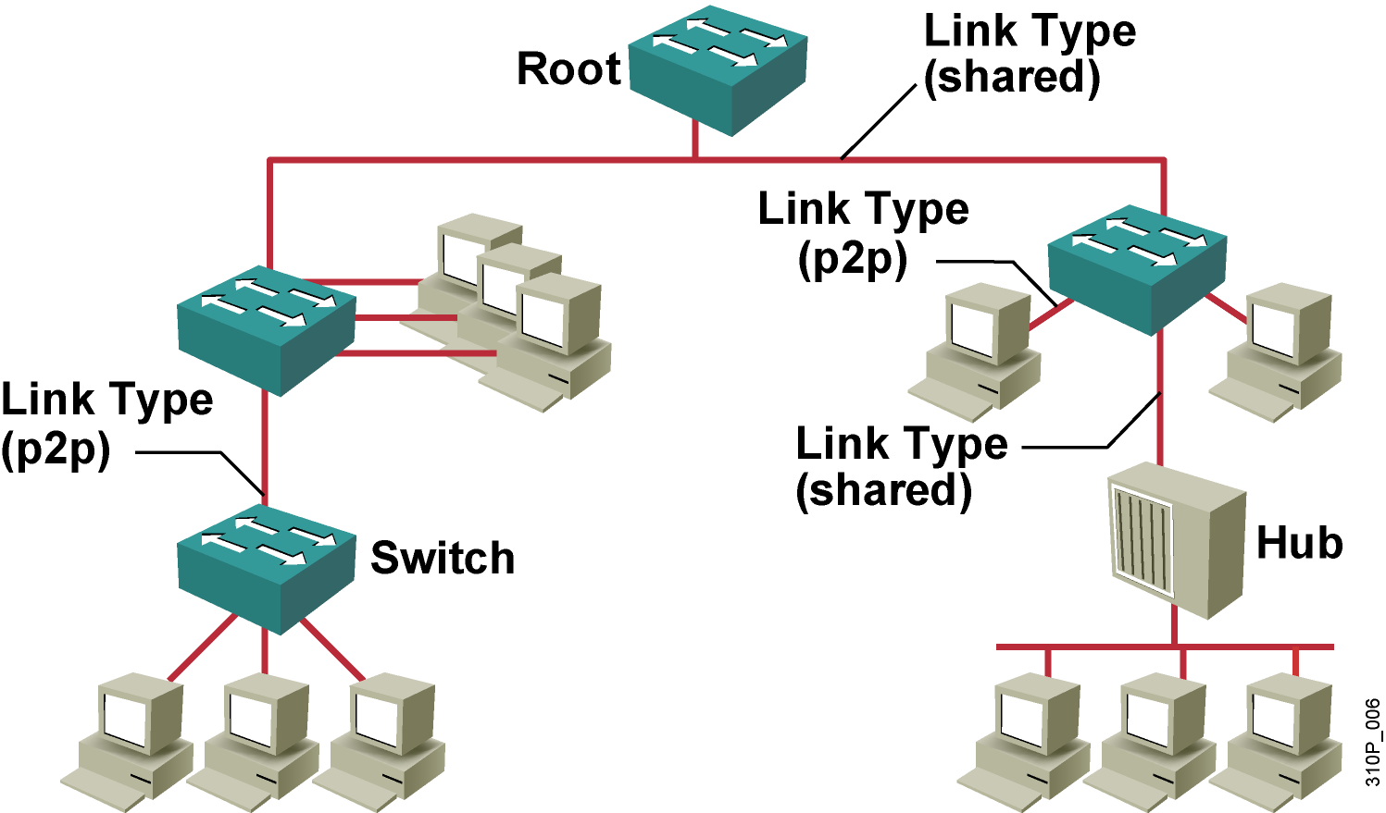
RSTP Link Types
*Full-duplex---point-to-point
*Half-duplex---shared
*通过接口命令修改其默认的链路类型spanning-tree link-type ？

Slide 31
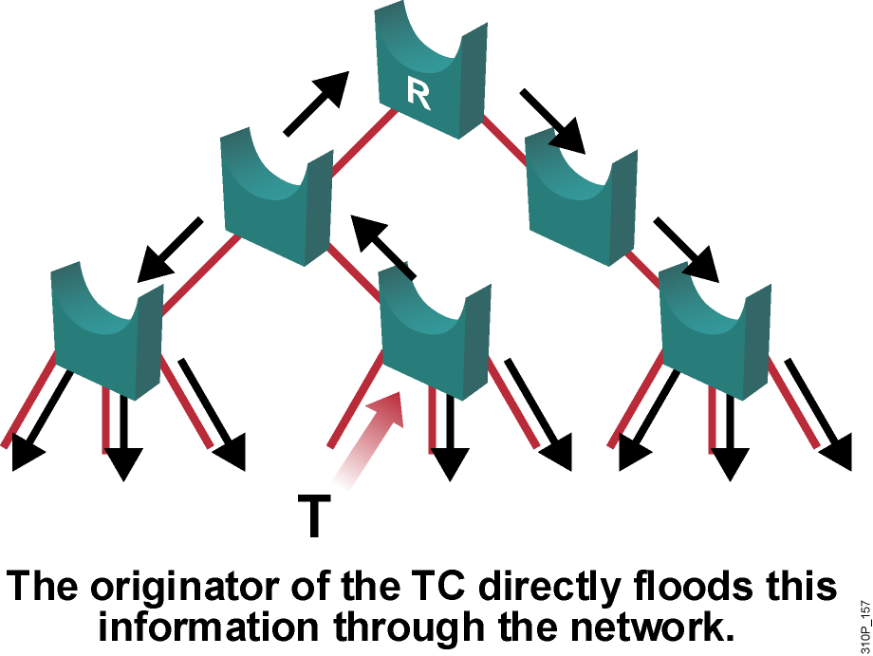
RSTP Topology Change Mechanism
只有当非边缘端口从阻塞状态到转发状态的时候才会导致拓扑变更.与802.1D不同,连接丢失并不会产生拓扑的变更.换句话说,如果某个状态进入Blocking状态将不会导致相应的网桥产生TC BPDU.
Notes:
802.1D产生拓扑变更的情况?
1、交换机端口变为Block端口的时候.
2、被选举为根端口或者指定端口的时候.
3、进入转发状态的时候会发TCN BPDU
新拓扑变化机制：
只有当非边缘端口从阻塞状态到转发状态的时候才会导致拓扑变更.与802.1D不同,连接丢失并不会产生拓扑的变更.换句话说,如果某个状态进入Blocking状态将不会导致相应的网桥产生TC BPDU.
STP的SW收到TCN：
有发现拓扑改变的交换机产生TCN BPDU，沿着去往Root Bridge的方向，最终发送到Root Bridge.
原因：STP中，只有Root Bridge才能产生configuration BPDU报文。
RSTP的SW收到TCN：
由发现拓扑改变的交换机直接泛洪这个消息到网络中。
原因：每个交换机可以自动产生/发送BPDU报文。

Slide 32
PVRST Implementation Commands
Configuring
  spanning-tree mode rapid-pvst
Verifying
show spanning-tree vlan 101
Debugging
  debug spanning-tree

Slide 33
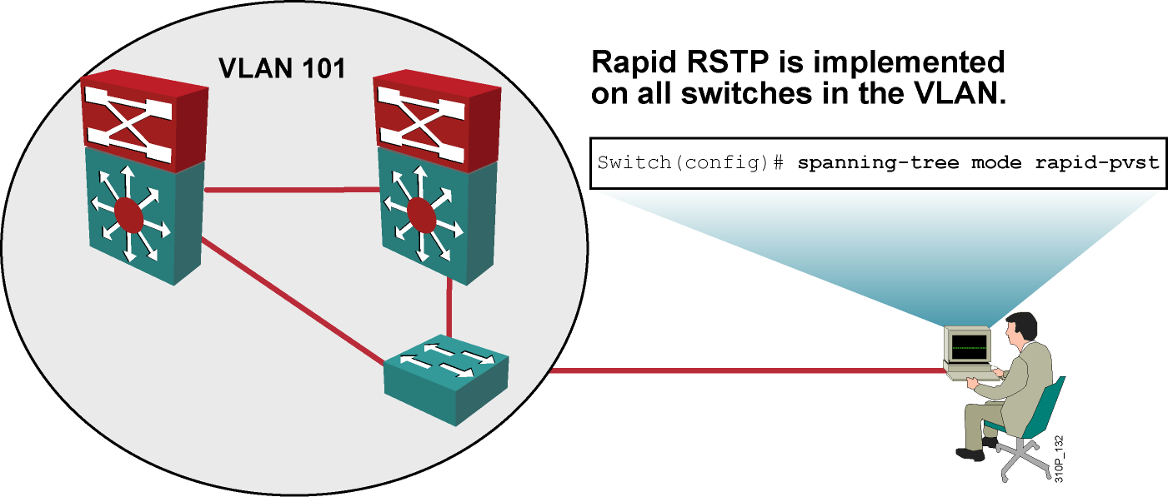
How to Implement Rapid PVRST(RPVST+)

Slide 34
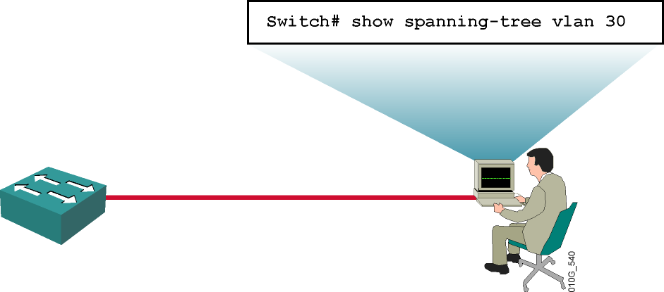
Verifying PVRST
Switch# show spanning-tree vlan 30
VLAN0030
Spanning tree enabled protocol rstp
Root ID Priority 24606
Address 00d0.047b.2800
This bridge is the root
Hello Time 2 sec Max Age 20 sec Forward Delay 15 sec
Bridge ID Priority 24606 (priority 24576 sys-id-ext 30)
Address 00d0.047b.2800
Hello Time 2 sec Max Age 20 sec Forward Delay 15 sec
Aging Time 300
Interface Role Sts Cost Prio.Nbr Type
-------- ----- --- --- -------- ----
Gi1/1 Desg FWD 4 128.1 P2p
Gi1/2 Desg FWD 4 128.2 P2p
Gi5/1 Desg FWD 4 128.257 P2p
Display spanning tree mode is set to PVRST.

